Slide 1
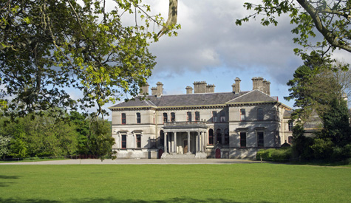
Stradbally Hall Cosby Family

Slide 2
The inside rooms of Stradbally Hall

Slide 6
Activities at Stradbally Hall

Slide 7
Fishing

Slide 8
Stradbally lake.
Stradbally lake is stocked with brown trout.
There are no spinners allowed in stradbally lake just hooks.
The lake is for fly and worm fishing.

Slide 9
Stradbally Hall weddings.

Slide 10
Paintball

Slide 11
Supershot paintball
Supershot Paintball Stradbally is based on the Stradbally Hall estate.
The course makes excellent use of the surrounding woodlands and terrain.
There are four game areas at supershot.

Slide 12
Equestrian

Slide 13
Stradbally Equestrian Centre
Adults, Children, Individuals and Small to Large Groups can be accommodated in these fun activities.
Trekking, Hacking & Cross Country Course
The fields, streams and woods on the estate excite the most intrepid trekker! 6-10 mile options. Safety Equipment supplied and max 6 in a group.

Slide 14
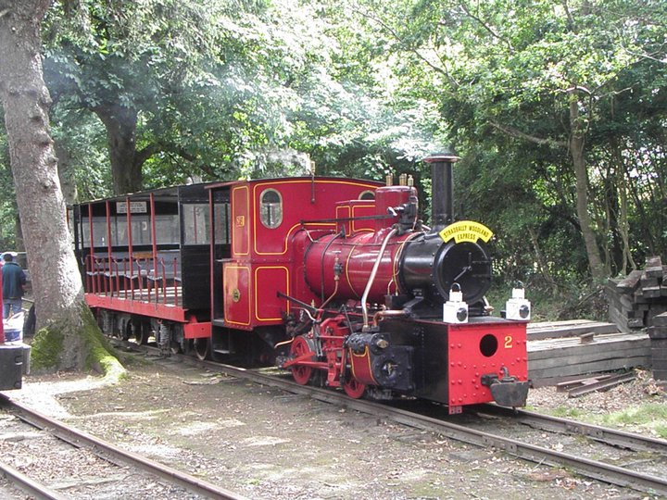
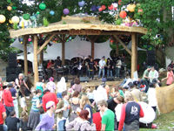
Other activities
Steam train
Electric Picnic
Stradbally steam rally
Point to point

